Slide 1
SECURITY ON AWS
CHAPTER 12

Slide 2
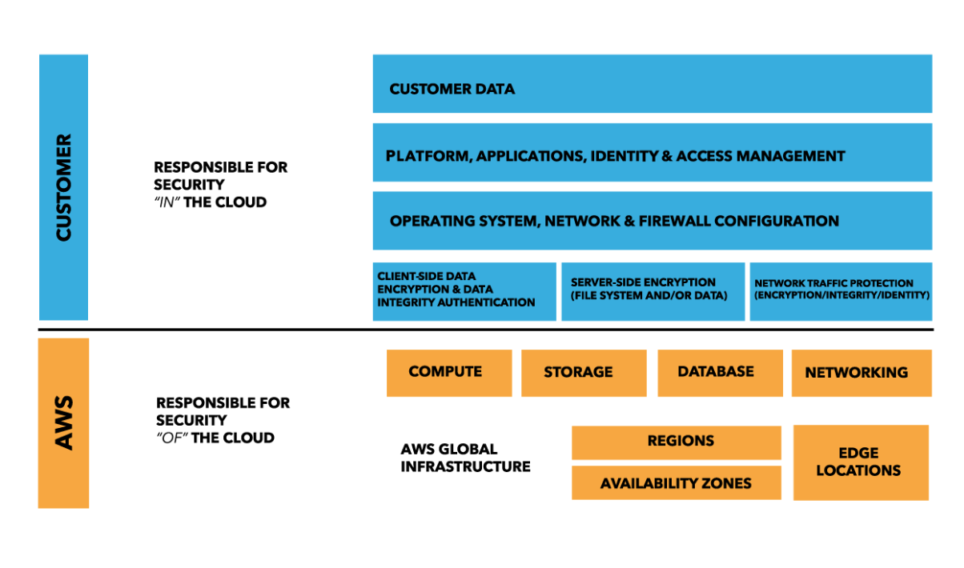
Shared Responsibility Model

Slide 3
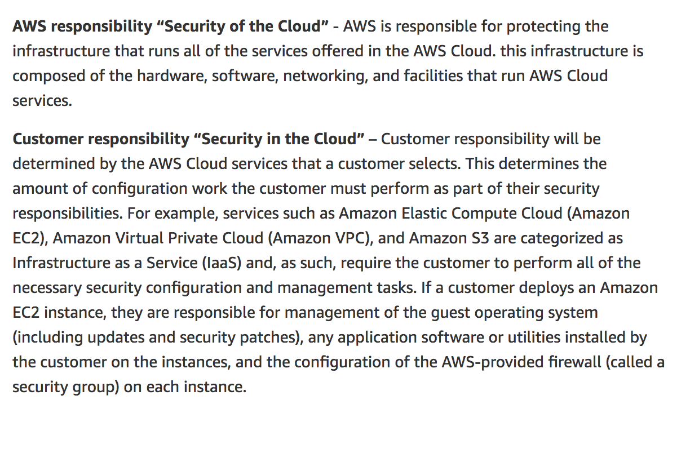
Security: Whose responsibility?

Slide 4
Penetration Testing
Get permission from AWS
Only allowed on certain Resources
Not be allowed in certain micro EC2 instances.

Slide 5
Security Best Practices
Managing IAM Users
Use of shared user identities, where multiple entities share the same credentials is strongly discouraged.
Groups:
When a user no longer needs access to a resource, you can remove them from the groups that provide access to that resource.

Slide 6
Groups Best Practice
IAM groups are a powerful tool for managing access to AWS resources. Even if you only have one user who requires access to a specific resource, as a best practice, you should identify or create a new AWS group for that access, and provision user access via group membership, as well as permissions and policies assigned at the group level.

Slide 7
IAM BEST PRACTICE
An IAM role lets you define a set of permissions to access the resources that a user or service needs, but the permissions are not attached to a specific IAM user or group. Instead, IAM users, mobile and EC2 - based applications, or AWS services (like Amazon EC2) can programmatically assume a role. Assuming the role returns temporary security credentials that the user or application can use to make for programmatic requests to AWS. These temporary security credentials have a configurable expiration and are automatically rotated. Using IAM roles and temporary security credentials means you don't always have to manage long - term credentials and IAM users for each entity that requires access to a resource.

Slide 8
DATA BEST PRACTICE
Protect Data in Transit with SSL , HTTPS
Protect Data at rest using Encryption

Slide 9
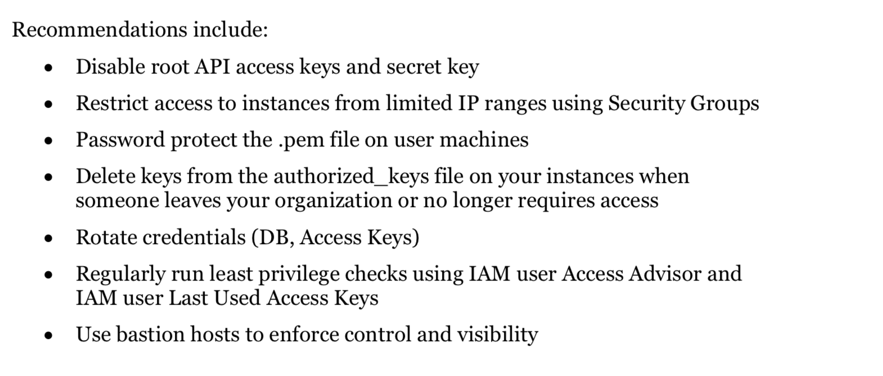
Secure Your Operating Systems and Applications

Slide 10
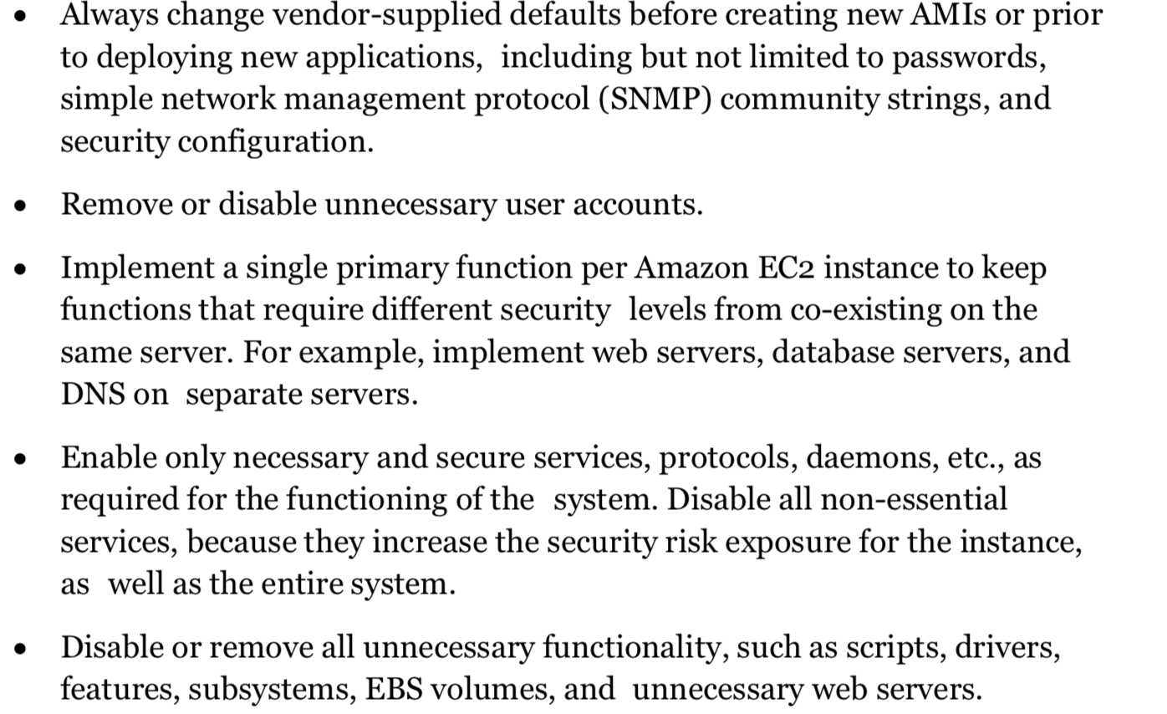
Using Additional Application Security Practices

Slide 11
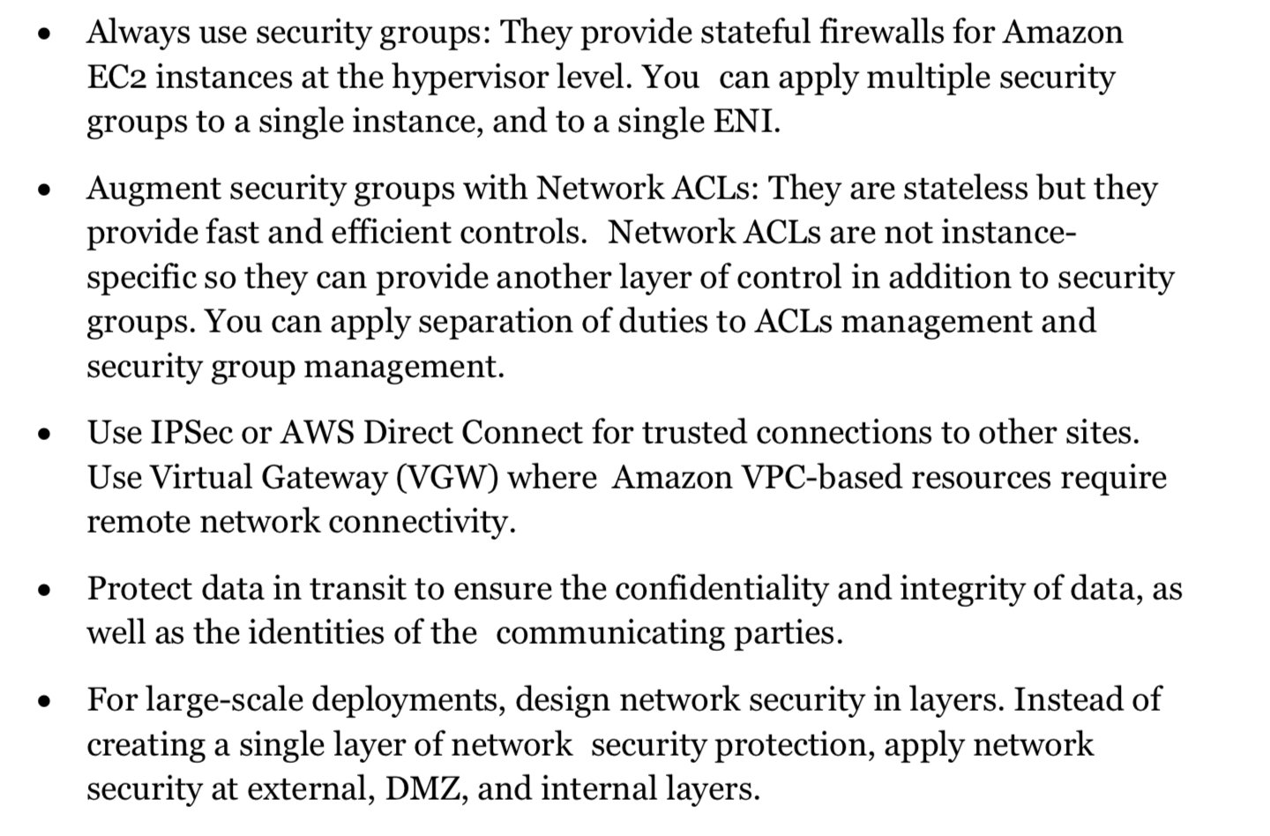
Network Security

Slide 12
Other Best Practices
Install Antivirus
Patching OS and software falls under customers responsibility.

